Slide 1
Assignment 2 Linear Systems and Approximations
Nusair Islam

Slide 2
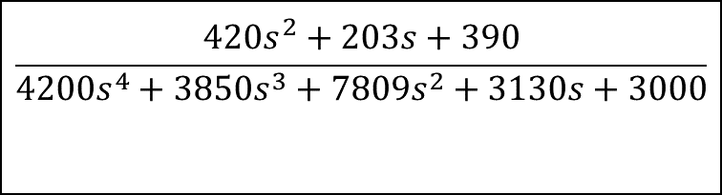
1. Transfer Function
CONSTANTS:
M1 = 3
M2 = 7
M3 = 3
M4 = 7
K1 = 3
K2 = 6
K3 = 2
B1 = 10
B2 = 10
B3 = 9
TRANSFER FUNCTION
$$\frac{420s^{2}+203s+390}{4200s^{4}+3850s^{3}+7809s^{2}+3130s+3000}$$
Input
Output

Slide 3
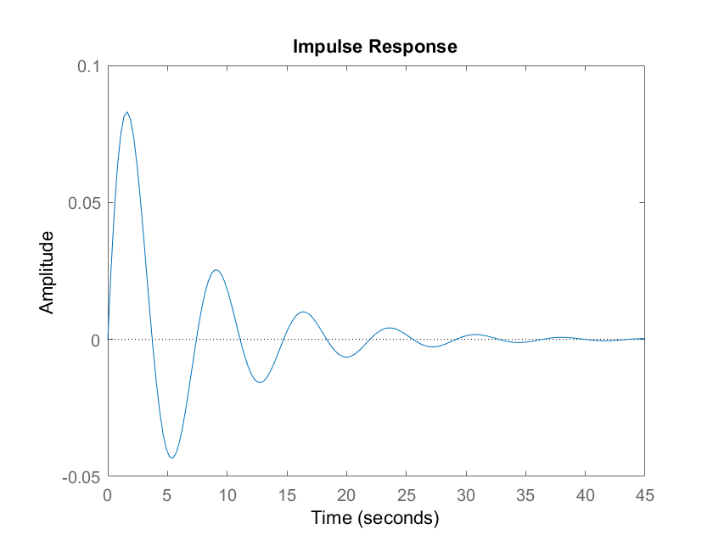
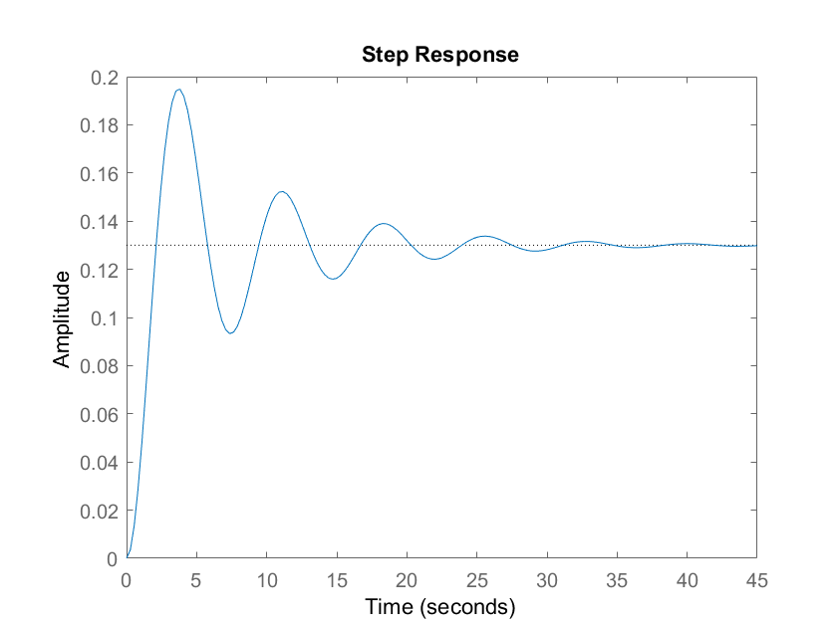
1. MATLAB Natural & Step Response

Slide 4
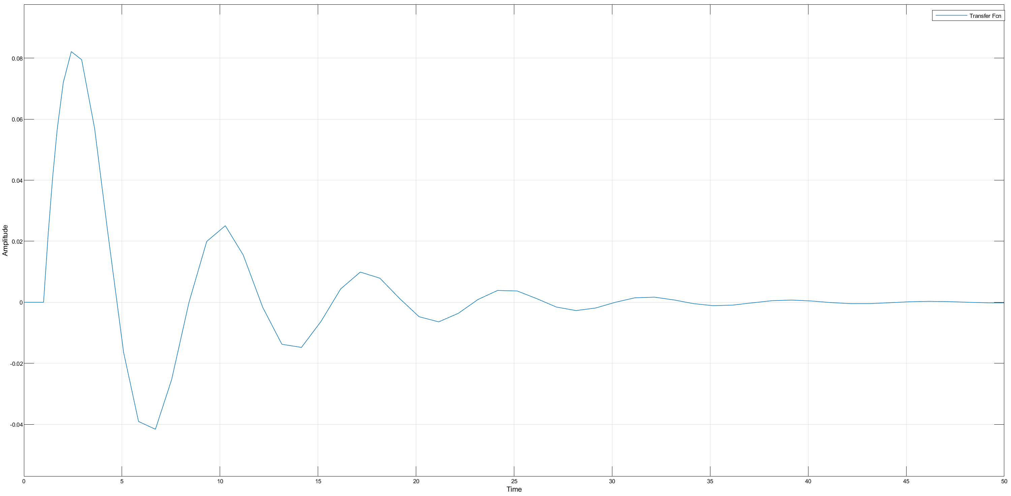
2. Simulink Natural Response

Slide 5
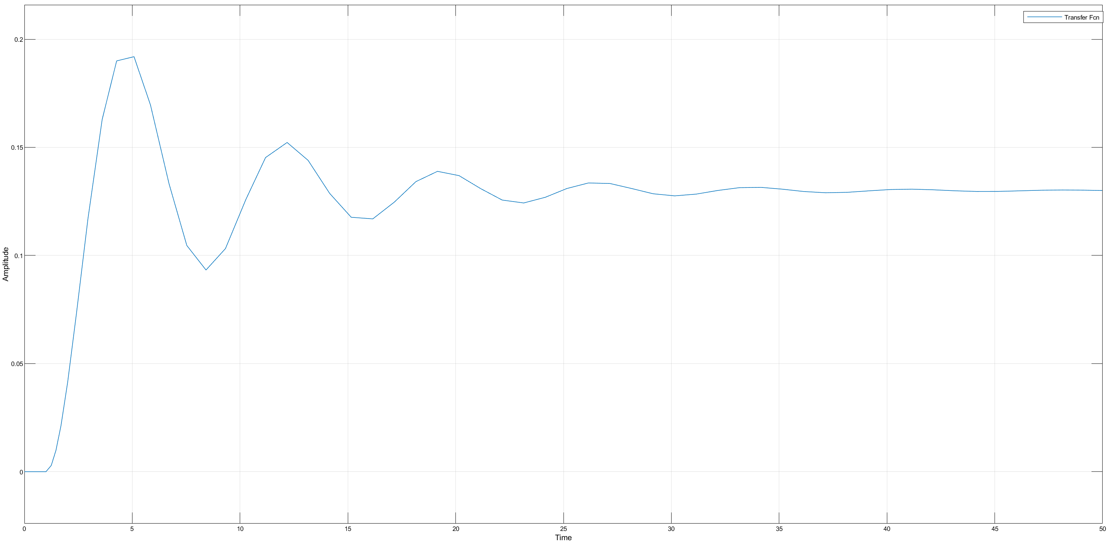
2. Simulink Step Response

Slide 6
3. When the output is v1, and without doing ANY math
I know the natural response will settle to 0 because after a certain amount of time the system will go back to steady state and the mass’s velocity will goto 0. The energy put into the system will be damped with the dampers
I know the step response will settle to 0 because the dF/dt = 0, the velocity of the spring v = 1/k*dF/dt, so the velocity of the spring will equal to 0, and the movement of the block will also be equal to 0.

Slide 7
3. When the output is x1, and without doing ANY math
I know the natural response will settle to 0 because from the previous question v1 will goto 0 because of damping. This means the system will go back to the previous state before the impulse, therefore the mass M2 will not change
I know the step response will settle to a finite value because as we keep applying a constant force, M4 will be in a lower position than its original position. Since string length needs to be constant, when the system goes to steady state M2 will be the same distance away from M4, and therefore in order to keep string length constant it must be lower in position, resulting in a changed x1

Slide 8
3. When the output is x2, and without doing ANY math
I know the natural response will settle to 0 because from the previous questions v1 will go to 0 because of damping. This means the system will go back to the previous state before the impulse, therefore the mass M2 will not change. It is the same principle as the last question.
I know the step response will settle to a finite value because as we keep applying a constant force, M4 will be in a lower position than its original position. Since string length needs to be constant, when the system goes to steady state M2 will be the same distance away from M4, and therefore in order to keep string length constant it must be lower in position, resulting in a changed x2. It is the same principle as the last question.

